Slide 1
Asthma Admissions: Time Series Analysis
July 24, 2023
Presented By:
Stephen Colegate, Ph.D.
Postdoctoral Research Fellow

Slide 2
Data Description
Daily number of patients admitted with asthma.
Timespan: January 1, 2016 – June 30, 2023.
Includes admissions from:
All(?)
Avondale
City of Cincinnati
Hamilton County
Eight Catchment Area
Overlap is present between these areas.

Slide 3
Data Description
Day | Year | MONTH_NUMBER | MONTH_NAME | MonthDate | AllAdmissions | AvondaleAdmissions | CinciAdmissions | HamiltonCountyAdmissions | EightCatchmentAdmissions
1/1/2016 | 2016 | 1 | January | 1/1/2016 | 3 | 0 | 2 | 2 | 2
1/2/2016 | 2016 | 1 | January | 1/1/2016 | 6 | 0 | 2 | 2 | 6
1/3/2016 | 2016 | 1 | January | 1/1/2016 | 0 | 0 | 0 | 0 | 0
1/4/2016 | 2016 | 1 | January | 1/1/2016 | 2 | 0 | 1 | 0 | 2
1/5/2016 | 2016 | 1 | January | 1/1/2016 | 0 | 0 | 0 | 0 | 0
1/6/2016 | 2016 | 1 | January | 1/1/2016 | 1 | 0 | 1 | 1 | 1
1/7/2016 | 2016 | 1 | January | 1/1/2016 | 0 | 0 | 0 | 0 | 0
1/8/2016 | 2016 | 1 | January | 1/1/2016 | 1 | 0 | 1 | 1 | 1
1/9/2016 | 2016 | 1 | January | 1/1/2016 | 0 | 0 | 0 | 0 | 0
1/10/2016 | 2016 | 1 | January | 1/1/2016 | 2 | 0 | 1 | 1 | 1
1/11/2016 | 2016 | 1 | January | 1/1/2016 | 1 | 0 | 1 | 1 | 1
1/12/2016 | 2016 | 1 | January | 1/1/2016 | 1 | 0 | 1 | 1 | 1
1/13/2016 | 2016 | 1 | January | 1/1/2016 | 3 | 0 | 2 | 2 | 3
1/14/2016 | 2016 | 1 | January | 1/1/2016 | 0 | 0 | 0 | 0 | 0
Focus on the All Admissions column.
Treat # cases weekly.

Slide 4
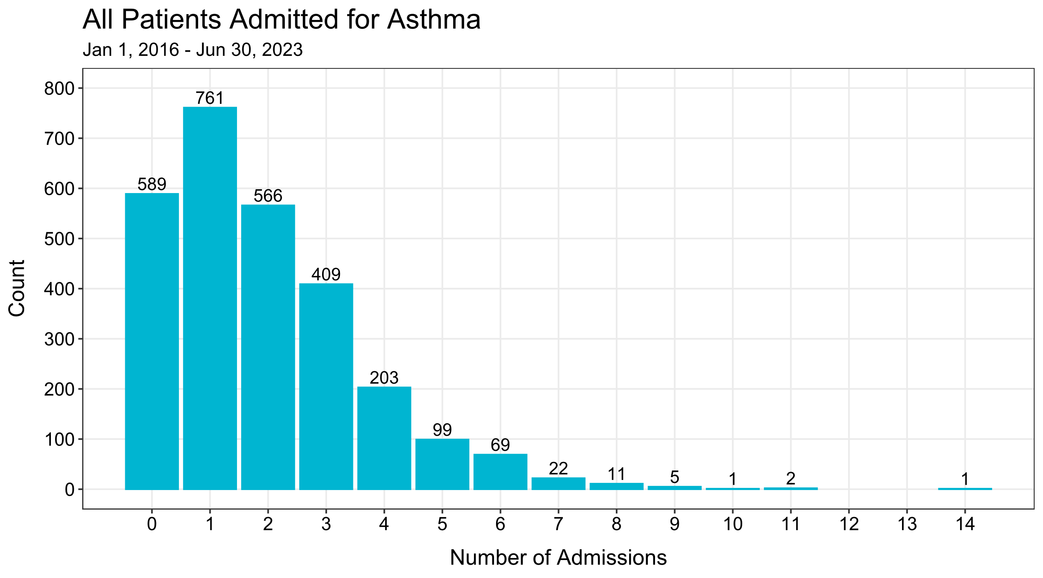

Slide 5
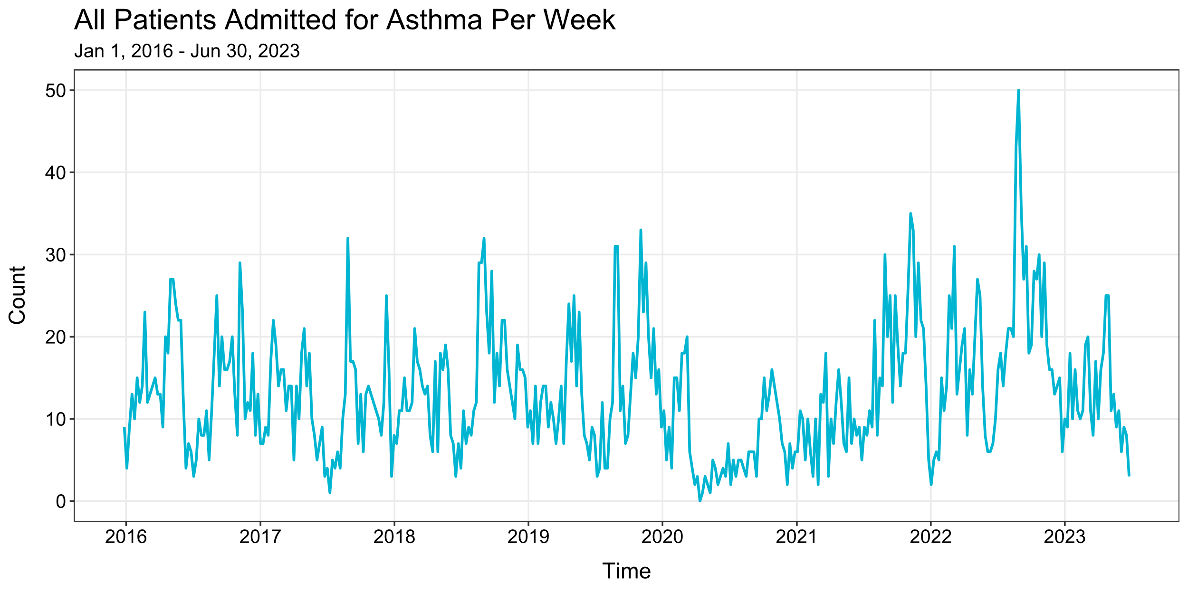

Slide 6
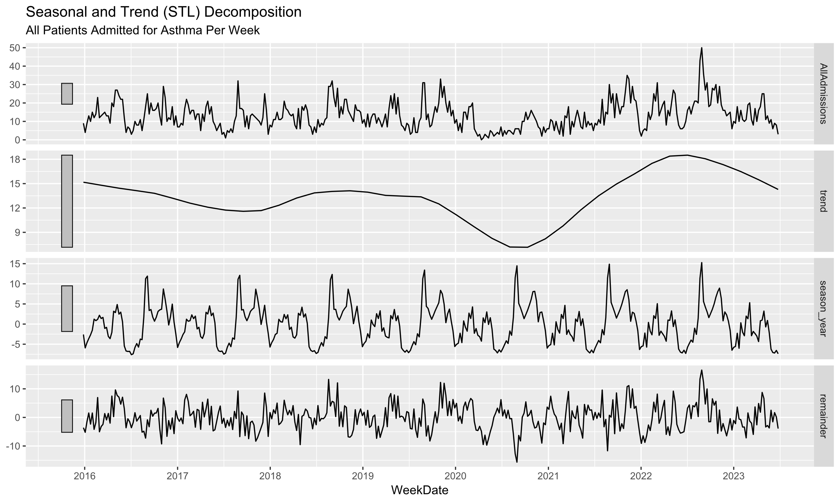

Slide 7
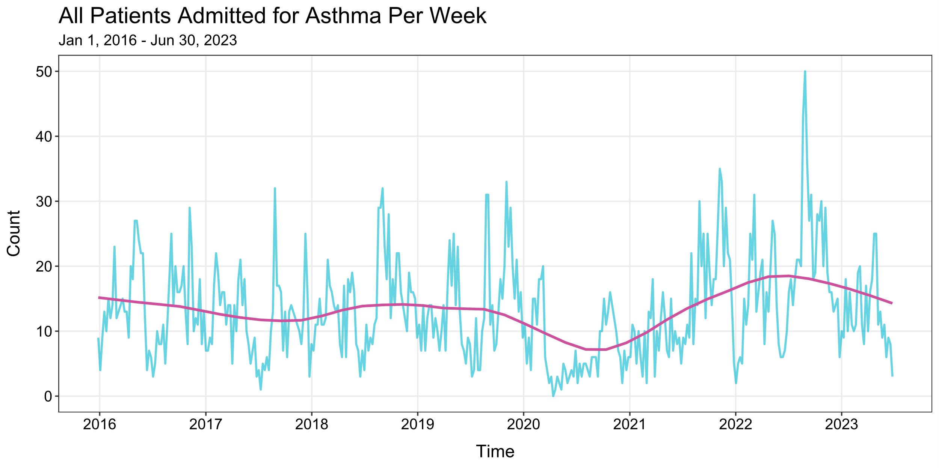

Slide 8
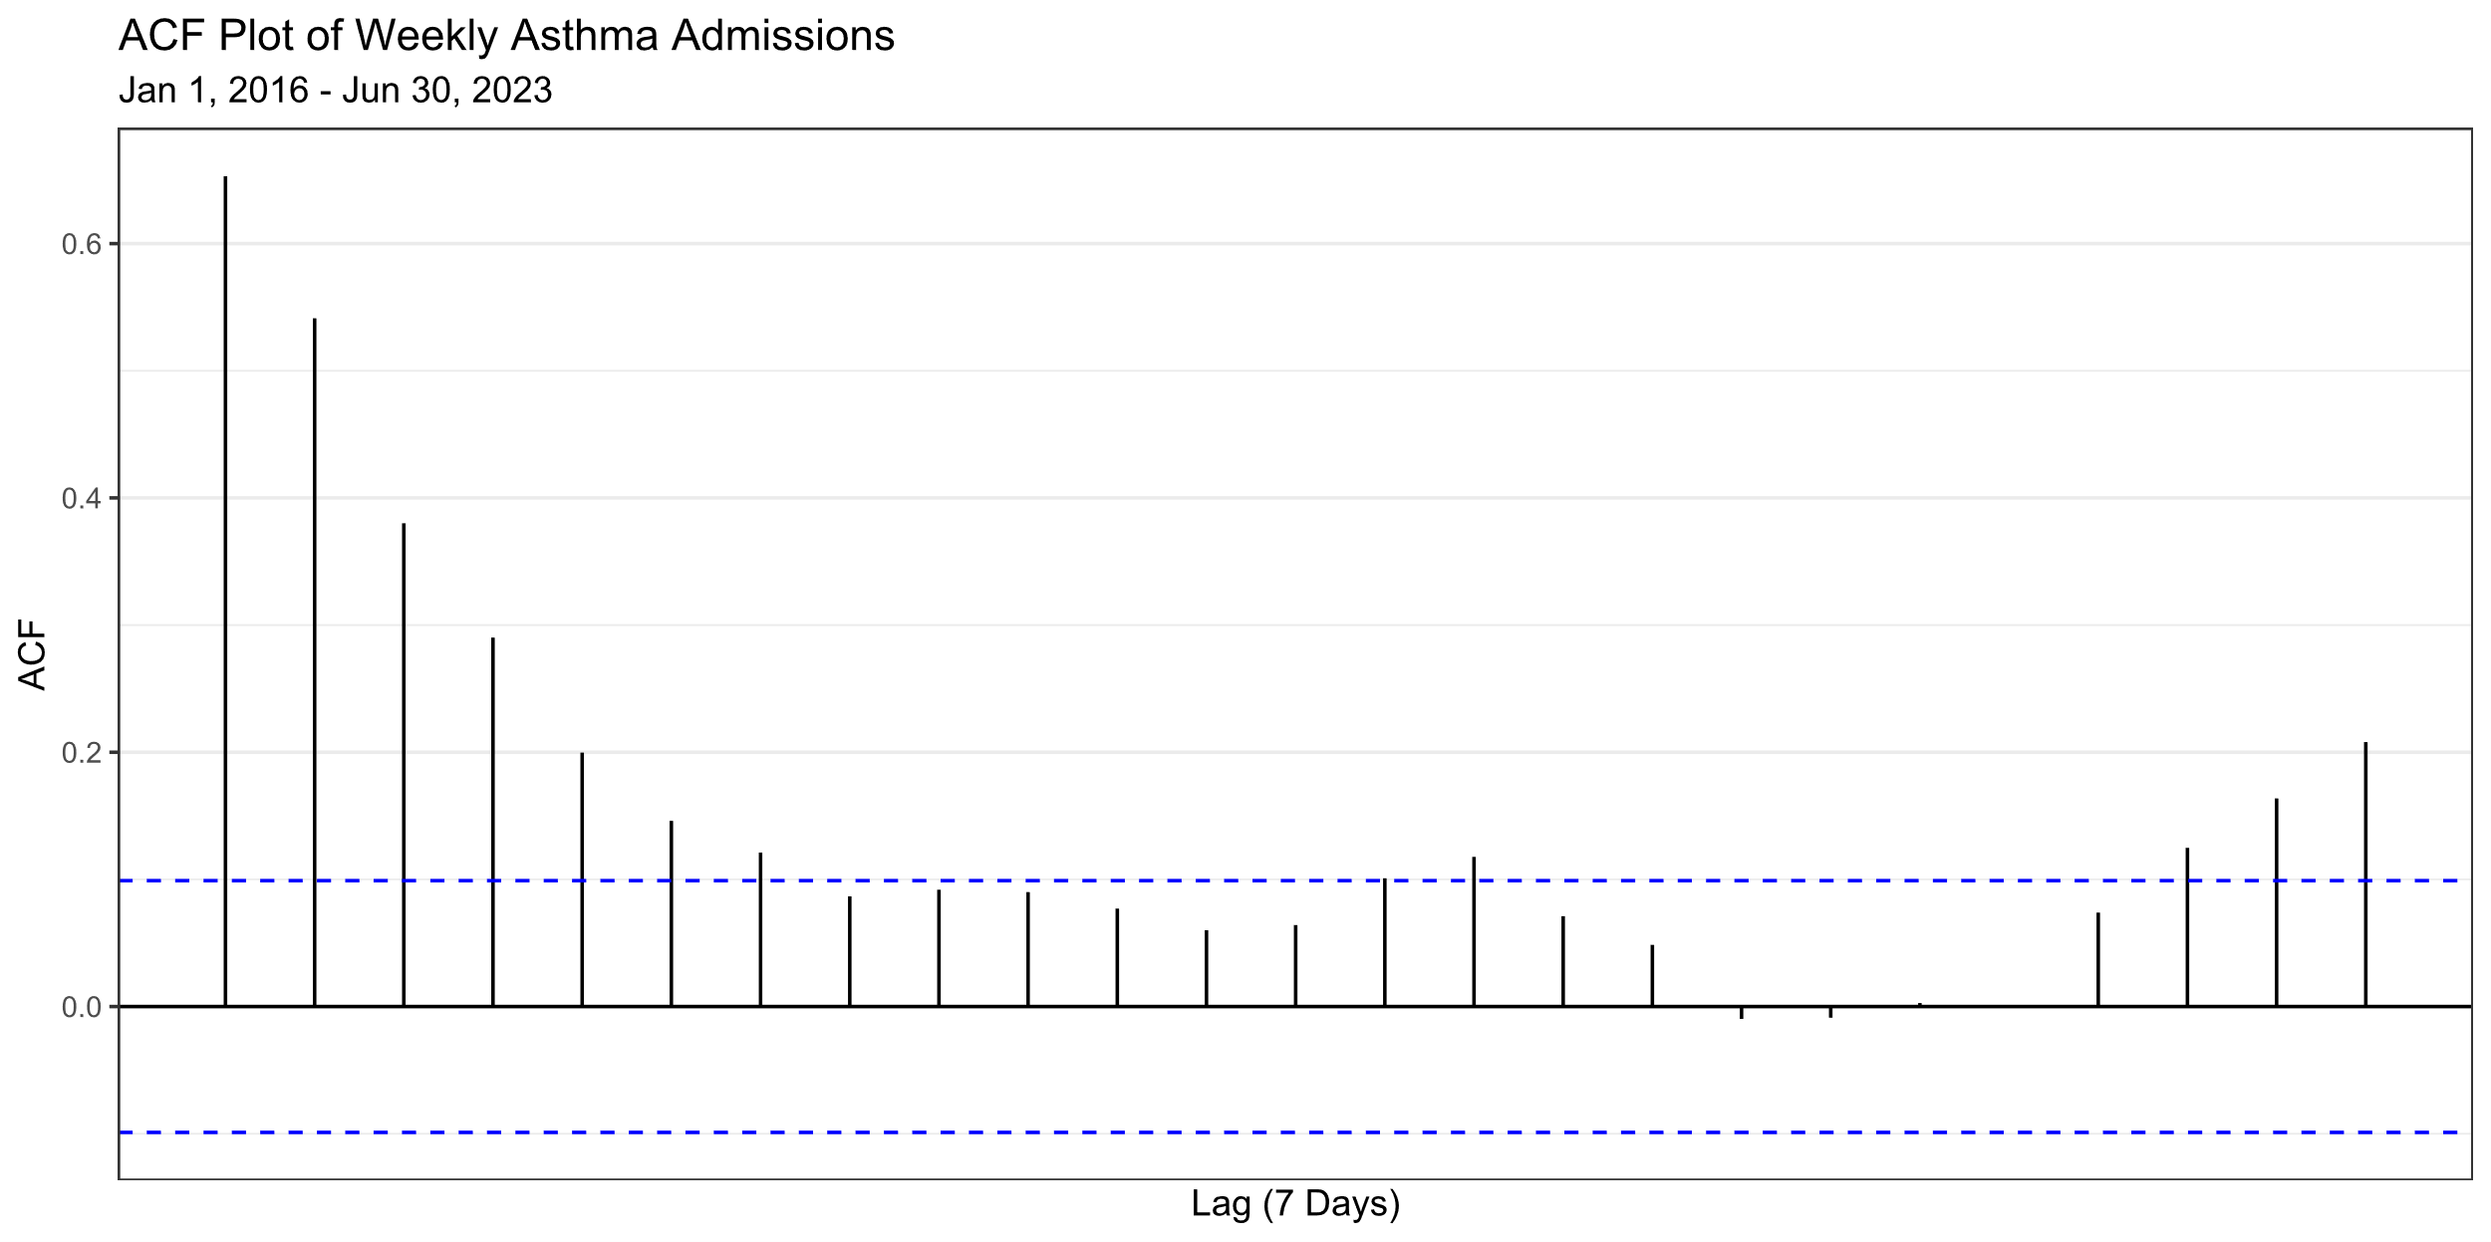

Slide 9
Data Exploration
Noticeable drop - Spring 2020.
No signs of trend.
No signs of seasonality.
One unusual high week
August 28 – September 3, 2022: 50
One unusual low week
April 12 – 19, 2020: 0
Weeks are strongly autocorrelated.

Slide 10
Discussion Questions
Weekly vs. Monthly Admissions?
Focus on asthma admittance forecasts.
Formulate model based on admission training data.
How may weeks to look back?
Cycle in weeks as new data come in?
How often to update model?
How to report predictions? How long the forecast?
Evaluation using test data.
Best way to evaluate performance?
How/When to make adjustments?
Interest in trend and seasonality.
How asthma admissions change throughout year?

Slide 11
THANK YOU!

